Slide 1

Distributing Cheat Detection
Applying Blockchain to Lessons Learned from Halo
Twitter: | @Jesse_Squire
GitHub: | https://www.github.com/jsquire
LinkedIn: | https://www.linkedin.com/in/JesseSquire
Biography: | https://www.jessesquire.com/about
Jesse Squire
Senior Software Engineer, Microsoft
Notes:
Hi, I’m Jesse
I’m an engineer at Microsoft
I was a member of the Halo Services Team at 343, from Halo 4 sustain through Halo Wars 2
When it comes to Blockchain, I am not a “true believer”
I don’t believe its the one technology to rule them all
No cryptocurrency
No Web 3.0 / DAPS

Slide 2

About This Talk
Conversational Style
No Bitcoin or Cryptocurrencies
Architectural Level
Not a How-To-Guide
Blockchain Agnostic
“Halo” == Halo 5: Guardians
Notes:
Let’s set some expectations
(CLICK) I’d like this talk to be more of a conversation and less of a lecture; feel free to ask questions and share comments along the way
(CLICK) Though we’re talking Blockchain, we’re not discussing Bitcoin or other cryptocurrencies
(CLICK) We’re going to be sticking to the high-level architecture today, not drilling down into code-level specifics
(CLICK) This talk is meant to be an ideation for possible techniques and approach; it’s not a how-to guide for implementing
(CLICK) I’m aiming to be Blockchain agnostic; I’m not here to pitch a specific Blockchain product or host. I may mention something specific to illustrate from time-to-time.
(CLICK) I’ll be using Halo as an example for this talk. Because I’m lazy, assume “Halo 5” when I say “Halo” unless called out otherwise
So, what’s this talk all about?
My current role is helping customers explore technology for their business
In exploring Blockchain for a partner, I started to think on ways that it mapped to Halo
Let’s take a look at our problem space
(CLICK – TRANSITION)

Slide 3

Problem Statement
Cheat Detection vs. Prevention
Goals
Accept that Players will Cheat
Give Players the Benefit of the Doubt
Punishment Should Fit the Crime
Notes:
In any multiplayer game, the integrity of the game is important. For players to be engaged, they need to trust in the fairness of the game.
This takes on a greater emphasis as we embrace games-as-a-service and LiveOps, where the player engages with a wider ecosystem and often across game titles.
(CLICK) The line between cheat detection and cheat prevention is mushy; what we’ll be looking at today is cheat detection.
For our purposes, we’ll define cheat detection as understanding what happened during a match and discovering attempts, successful or not, at cheating.
This isn’t to imply that real-time prevention is unimportant; like any security, cheating mechanisms are best applied in layers.
We’ll make the assumption that there are validations in place to prevent blatant and obvious cheating.
(CLICK) So, if that’s the case, what are the goals of cheat detection?
(CLICK) Players are apt to cheat, even when it doesn’t impact the game directly
Sometimes for Halo rankings example
(CLICK) Players deserve the benefit of the doubt; they’re engaged with your product and potentially invested in it.
Better to let the guilty get away with it than punish the innocent
(CLICK) Prevention should be limited to only those obvious cases where the game is impacted for others
Psychology tells us that the more a cheater “gets away with it” the more likely they are to cheat again.
(CLICK) Make sure that the punishment fits the crime
You want players to play
A gentle reminder can often discourage those who are just curious what they can get away with
Obviously, repeat offenders and more severe offences need harsher action
Let’s talk about some high level concepts of cheat detection…
(CLICK – TRANSITION)

Slide 4

Cheat Detection
Understand What Happened
Challenges
Missed Observations
Out-of-Order Observations
Multiple Perspectives (clients / server)
Misleading Observations
Notes:
(CLICK) The first order of business for cheat detection is to build an understanding of what happened in a game.
A common way that this is done is by having game clients and servers make observations of key events in the game as they happen
Often, these are sent via telemetry and used for various purposes
(CLICK) This sounds easier than it often is; a number of factors can make this a challenge.
(CLICK) The recording of observations is typically considered a best effort operation
Not allowed to impact the game on a failure
May be retried, but often just dropped due to network budgets
Even if successfully sent, it’s usually fire-n-forget so there may be unknown problems on the other end
(CLICK) Just because observations are sent in a certain order doesn’t guarantee that they’ll be received in that order.
There are ways to ensure order, but they’re slow. For most games, the trade-off isn’t worth it or may not be possible.
(CLICK) For most multiplayer games, including those with a dedicated server, there are multiple sources of information.
Understanding what happened and when is fuzzy
Teacher on a playground; lots of different stories and no clear “winner”
Because there are multiple sources, there’s no clear order of events
(CLICK) Even on secure platforms, there is no guarantee that the observations being sent aren’t intentionally misleading in an attempt to cheat.
Hardening these for better integrity is possible, but often comes with a performance trade-off
Since observations are often non-critical, the trade-off is often not worth it
For a concrete example, let’s talk about how Halo does cheat detection.
(CLICK – TRANSITION)

Slide 5
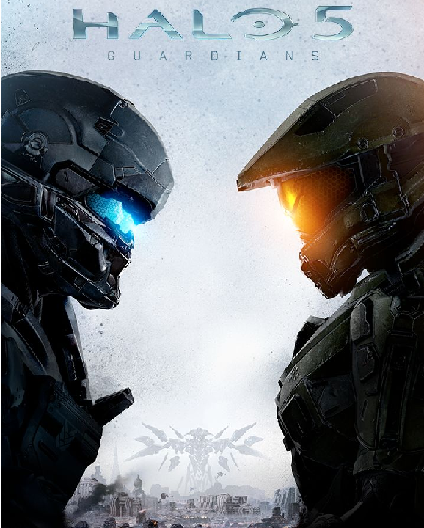
How Halo Does
Cheat Detection
Halo’s Dedicated Server
Telemetry
Processing Pipeline
$$$
Notes:
(CLICK) Historically, Halo has used a peer-to-peer model for multiplayer
Halo 5 moved to the dedicated server
Server runs the full simulation
Server is the source of truth for most things -> Grenade example
Client is the source of truth for some things -> Headshot example
(CLICK) One of the biggest investments for 5 was the telemetry system
Halo sends a lot of telemetry and uses it in a variety of ways, including for cheat detection
For a player-centric view, it’s easy to assemble a clear picture since there is source of truth and events can sequence -> Commendations
For a game-centric view, it’s very difficult to assemble a clear picture since both the client and server send telemetry
Building a clear picture is a fuzzy process; events can’t be sequenced and time stamps aren’t reliable
(CLICK) Halo uses an extensive processing pipeline to try and overcome this
Events are pulled in batches
Events are put into a relative ordered via fuzzy matching
Events are processed by Trill, allowing complex rolling windows and “over time” views
(CLICK) All of this takes an enormous amount of power and time
Halo can justify this because the same telemetry and pipeline feed other areas
>> Commendations
>> Intelligence for design and business use
>> Cheat Detection
We’re not all Halo. There has to be a more accessible and cost-effective way
(CLICK – TRANSITION)

Slide 6
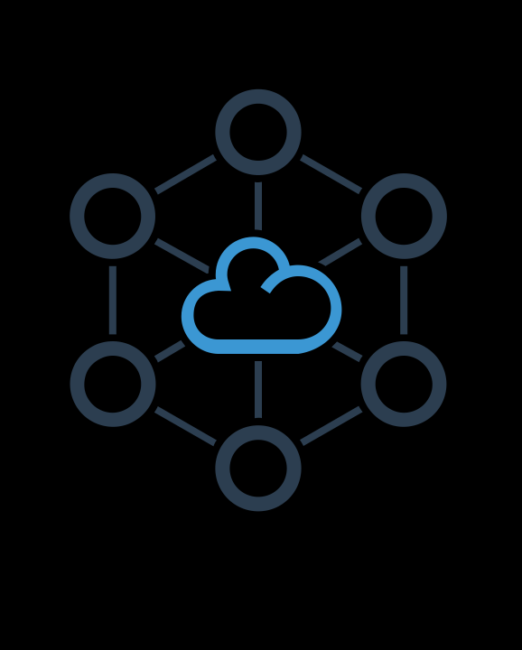
Can We Share
the Responsibility?
Ask Players to Help
Concerns
Security
Griefing and Collusion
Cost
Notes:
(CLICK) Instead of paying a huge amount to centralize, it would be nice to be able to distribute the work.
What if we asked players to help?
(CLICK) That’s an idea worth exploring, but it comes with some concerns.
(CLICK) Allowing players to help means code running on user devices; it lends itself to potential exploits
(CLICK) Having players police each other can lead to griefing or collusion. We need a way to ensure that we’re not allowing players to interfere.
(CLICK) Developing a robust peer-to-peer model with the needed security protections could be costly.
What does Blockchain offer us here?
(CLICK – TRANSITION)

Slide 7

What does
Blockchain Offer?
Distributed Processing
Peer-to-Peer Functionality
Consensus Voting for Observations
Resistant to Exploitation
Role-Based Security (in its own way)
Notes:
There are different type of Blockchain, each with different characteristics.
My goal isn’t to give a comprehensive analysis or comparison of each.
We’ll focus on those that are helpful in our scenarios and touch on others only lightly
I’m also going to keep discussion at a relatively high level. For those of you that may be familiar, I’ll ask forgiveness for being a bit imprecise in places and glossing over some detail.
We’ll take a closer look at some of the details of Blockchain in our context shortly, but at a high level, let’s look at what it offers us:
(CLICK) No single central authority; processing responsibility is distributed among the members
(CLICK) Peer-to-Peer communications without having to implement the details
Whether you’re game is using P2P a dedicated server model, or something else, Blockchain handles its own communication
(CLICK) Resistant to exploitation
Each Blockchain implementation offers a mechanism for members to vote on observations to accept or reject
These are the “consensus algorithms” that you often hear about
(CLICK) At worst, these mechanisms should allow 1/3 of your members to be badly behaved and still protect the integrity of the data
(CLICK) While not true of all Blockchain implementations, many support the concept of different roles for members. For example,
Some members may be able only view observations
Some can view and submit
Some can vote on which to include or reject
Some can be designated as trusted for operations
Let’s dispel some of the common wisdom about Blockchain and start talking through some of the basics.
When you hear about Blockchain, there are some usual connotations that are associated with it. For those that have some knowledge, what things do you associate with Blockchain?
(POLL AUDIENCE)
Public
There are public and private
Persistent
Some can live a short time, if the data is not interesting. Ephemeral
Slow
Highly dependent on the consensus mechanism
Currency is necessary
Up to the consensus mechanism
Blockchain is unhackable
It’s “tamper evident”
Depends on the consensus mechanism, but can withstand 1/3 – 1/2 bad actors. 51% can always tamper.
(CLICK – TRANSITION)

Slide 8

Blockchain Basics
Digital Ledger of Transactions
A Transaction is Just Some Data
Members Submit Transactions
Transactions are Validated
Transactions Become Blocks
Blocks are Shared Peer-to-Peer
Members Vote to Accept or Reject
Accepted Blocks Added to the Ledger
Block 1
Block 2
Block 3
Header
Hash of Previous Header
... (other fields)
Header
Hash of Previous Header
... (other fields)
Header
Hash of Previous Header
... (other fields)
Transactions (Merkle Tree)
Transactions (Merkle Tree)
Transactions (Merkle Tree)
Notes:
I’m going to start shifting over some terminology to what you’ll commonly hear around Blockchain. For those who have familiarity with Blockchain, you may notice some loose terminology and that I’m glossing over details; again, my goal is to be approachable and stay at a high level.
So, what is Blockchain?
(CLICK) In a nutshell, Blockchain is a distributed data structure that may or may not have some behavioral components
It’s a distributed ledger of transactions – and the order of them
Based on digital signatures, hash algorithms, and Merkle trees
Each member of the chain has their own copy, rather than having a single central copy
Communication happens peer-to-peer, rather than through a central authority
(CLICK) Transactions can vary in meaning, from “I have a thing” to “I did a thing” to “this thing happened”.
In our context, these will primarily be observations about the game
(CLICK) Members of the chain submit transactions
Each submission is digitally signed by the member’s private key, so that its origin is known
Transactions are peer-to-peer broadcasted
(CLICK) Received transactions are validated
The manner of this will vary by Blockchain
It may just be the identity of the creator, it may be more involved
(CLICK) Transactions are grouped together into blocks
Until it appears in a block, a transaction isn’t part of the permanent record
Each block has a reference to the block that came before it as part of its identity
The block contents and references are hashed to protect the block
This allows attempts to change the block or history of the chain to be detected
(CLICK) Blocks are shared peer-to-peer with the chain
(CLICK) Members vote on blocks to accept
Conflicts are resolved by consensus
Rejected blocks are dropped, its transactions are used in a new block
(CLICK) Accepted blocks become part of the ledger
(CLICK) Here is a basic representation of a blockchain
Block Header
Has Hash of Previous
May have other fields, such as a timestamp and other metadata
Transactions stored in a Merkle tree for quicker integrity checks
A core Blockchain goal is to keep every copy on each member in-sync.
In those cases where there are disagreements and the chain forks, the consensus mechanism brings it back to sync.
Now that we’ve got the basics, let’s talk a bit about consensus…
(CLICK – TRANSITION)

Slide 9

Blockchain
Consensus
Proof of Work
Proof of Elapsed Time
Byzantine Fault Tolerance (multiple)
Proof of Stake
Proof of Importance
Notes:
Different Blockchain implementations use different consensus models.
While each has the same goal, they have very different characteristics and can have a big impact on how the chain operates
(CLICK) Proof of Work
This is the famous one that most are familiar with
Involves computing the answer to a mathematical puzzle intended to be computationally expensive
Intentionally slow
The concept is to make it near impossible for members of the chain to collude and control the chain due to the needed computational power
Conceptually, you’d need to control 51% of the compute power of all members of the chain to dominate
(CLICK) Proof of Elapsed Time
Involves assigning a random time interval in a lottery fashion
The first to submit a block after their time interval elapses “wins”
Intended to be “slow enough” and introduce a random factor to avoid collusion
Not widely used, only Hyperledger (IBM) as far as I know
Relies on a central authority, as the arbiter of the random assignments – centralization kind of defeats the purpose
(CLICK) Byzantine Fault Tolerance
This is more a classification of several consensus algorithms than it is one of its own
This covers “federated”, “simplified”, and “agreement”
The general concept of these is to use rounds of voting and sharing of information until a big enough consensus is reached
In a BFT system, up to 1/3 of the members can be malicious or colluding before the chain is compromised
(CLICK) Proof of Stake
Gives more voice to those that have more invested into the ecosystem
This can be in the form of reputation, currency, or some other
Members wager some of their stake when proposing a block; if accepted, they get it back. Otherwise, they lose it.
There is often a punishment for those who misbehave or continually propose rejected blocks
Conceptually, you’d need to control 51% of the stake in the chain to dominate – with penalties, this should quickly correct itself
(CLICK) Proof of Importance
Gives more voice to those recognized as more important to the ecosystem
The more contributions that a member makes to the overall process, the more “trusted” they become and, therefore, important
Very similar to POS, but based on contributions rather than potential ranking earned elsewhere (like Gamerscore, etc)
There is often a punishment for those who misbehave or continually propose rejected blocks
Conceptually, you’d need to control 51% of the stake in the chain to dominate – with penalties, this should quickly correct itself
The last two are of most interest to us to us. Let’s move on to a quick look at the roles of a Blockchain
(CLICK – TRANSITION)

Slide 10

Blockchain Roles
Light Member
Member / Full Member
Validator / Miner
Oracle / Agent
Notes:
Different Blockchain implementations have different roles for members, and different permissions on what those members may do. What follows are broad generalizations that you should expect to vary with different Blockchains.
(CLICK) Light Member, aka Light Node
This role allows for reading transactions and blocks only; they can’t submit or validate
Cannot propose blocks nor vote for consensus
Only exists in some implementations and isn’t common, in my experience
(CLICK) Member, aka Full Member, aka Full Node
Can read and submit transactions, but can’t validate
Can propose blocks, but not vote for consensus
This is the default role for most implementations and is often the lowest permission
(CLICK) Validator, aka Miner
Can read, submit, and validate transactions
Can propose blocks and vote for consensus
(CLICK) Oracle, aka Agent
A trusted authority on the chain
Can read, submit, and validate transactions
Can propose blocks and vote for consensus
Often carries more weight when participating in operations
Can perform privileged operations, such as communicating with external sources and providing trusted attestation
One last thing before we turn our attention back to gaming – a quick word on running code on a Blockchain
(CLICK – TRANSITION)

Slide 11
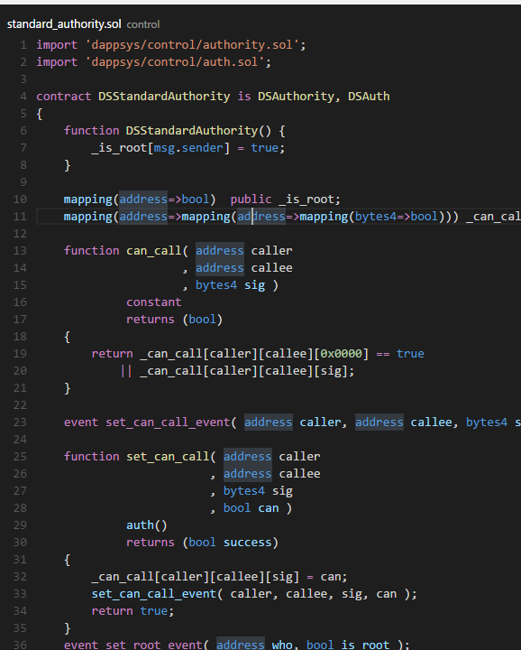
Custom Code on a
Blockchain
Smart Contracts
Application Blockchain Interface (ABCI)
Notes:
The first Blockchain implementation was purely a message-driven system. Transactions were submitted and any action that followed was triggered by seeing a certain transaction and often by submitting a corresponding result transaction.
The Ethereum Blockchain introduced the concept of “Smart Contracts,” which are stateful components that exist on a Blockchain, written in some form of code that can be invoked.
The most prominent is Solidity
The original intent was to allow for multi-phase operations to be recorded and witnessed using state changes
For example, I call the contract to say that I’m buying a game from a digital store and place my currency in escrow.
The contract state now reflects that I’ve escrowed my currency; I can’t remove that unless the contract allows a cancel operation.
The store calls the contract to post a digital code for the game, which is now held in escrow and hidden from me.
If the store doesn’t send the code within a certain period of time, my currency is returned.
If then call to release the escrowed funds, the contract validates the code, and releases the code to me and the currency to the seller
If the code doesn’t validate, either my funds are returned or continue to be held until the dispute is resolved.
Different callers may have different permissions within the contract.
For example, only an Oracle may have permission to execute an operation that results in an external call being made.
The result of that call may change the state of the system, such as setting the current price of gold for the day.
Tendermint introduced the concept of the Application Blockchain Interface as a neutral layer that allows the core Blockchain to exist independent of an application that manages state, including validation of transactions and blocks.
In this model, the Blockchain engine responsible for peer-to-peer communications, consensus, and fault tolerance, freeing your application from those details
There is a lot more to Blockchain, but at this point, we have enough of the basics to turn our attention back to cheat detection and gaming.
(CLICK – TRANSITION)

Slide 12

Distributed Cheat
Detection Goals
Understand a Game Through Observations
Create a Single View of the Game
Use Fewer Server/Service Resources
Trusted Players Help Review Games
Flag Suspected Problems for Follow-Up
Notes:
Looking back at cheat detection with what we know about Blockchain, we can come up with some goals to accomplish
(CLICK) We want to understand what happens in a game session using our existing telemetry observations.
(CLICK) We want to organize those observations and create a single view from the multiple perspectives.
(CLICK) We want to lower costs by using fewer centralized resources to do the inspection and review of game sessions.
(CLICK) To do that, we’ll try to get players involved by asking those who are the most invested in our ecosystem, as those will be the more trusted.
(CLICK) We don’t want to take any punitive action or make authoritative decisions, instead we want to flag the game session for further review.
Next up, let’s figure out what we need to make that happen.
(CLICK – TRANSITION)

Slide 13

What We Need
Our Game
An understanding of when players are online and available
A way to rank player investment in the ecosystem, such as reputation or leaderboard position. (Best if this can be increased or decreased arbitrarily)
Notes:
In order to take advantage of Blockchain in the context that we’re talking about, our game will benefit from:
(CLICK) A way to know which players are online, available, and may be able to help with cheat detection.
If you’re offering matchmaking or other social features, there is a good chance that you already have this
If you’re using one of the console or PC services, you may be able to take advantage of their presence system
(CLICK) A ranking for players, so that you can identify which players are more invested in your game or overall ecosystem.
For example, a player with a higher reputation, game currency, or position on a leaderboard in your game is likely more invested than a player with less
A player with more achievements or trophies is likely more invested than a player with less
A player with more time played in your games is likely more invested than a player with less time
The reason we’re interested in this is because a player that is more invested in the game or your ecosystem often is passionate and cares about the health of the game and keeping it competitive. They’ve invested time and energy and have status or other things to lose if others cheat.
Having this measure able to arbitrarily increase or decrease is a good way to reward players who help validate games and apply a punitive punishment to those who participate in game validation dishonestly.
Now we know what our game needs, what about the Blockchain that we’ll want to use?
(CLICK – TRANSITION)

Slide 14
What We Need
Blockchain
The ability to deploy and remove a Blockchain instance on demand
Transaction validation that can be customized
A customizable consensus algorithm, preferably proof-of-stake
A means to designate a member as an Oracle or otherwise explicitly trust a designated member
Support for an Oracle to invite and kick Validator members
Notes:
There are multiple ways that we could go about implementing cheat detection, but for these examples, our Blockchain will have:
(CLICK) The ability to deploy a new Blockchain instance on demand, so that we can have an ephemeral chain-per-match.
Once a game is validated and attested, the Blockchain data is no longer interesting; it is redundant to our telemetry observations
The purpose of the chain is to allow peer validation by players; review of any potential cheating will be done against our telemetry
If we decide to reflect transactions to our services, the Oracle can do so as blocks are finalized
Keeping the block scoped to a given match prevents having to download a huge amount of data to validate
(CLICK) Customized transaction validation will come in handy.
This will allow players to perform sanity checks on incoming transactions according to game rules and reject those that don’t make sense
For example, if Player A and Player B both report that Player B shot Player C, we can safely omit Player A’s report to avoid duplication
(CLICK) Customized consensus algorithm will allow us to include game semantics when solving disagreements on blocks
A proof-of-stake algorithm will allow us to use an attribute of the player (like ranking) or something the player has (like game currency) to incentivize honest and fair validation.
Even if we choose to reward players outside the process, such as a static amount per match attested, we can apply a punitive cost if they misbehave or drag the system down
(CLICK) Though our goal is to distribute cheat detection, we don’t want to remove a central authority; we want to have the dedicated server or a game service be able to act as the final authority when needed.
This includes overriding validation and consensus if needed
Any off-chain communication, such as with game services, will be purview of the Oracle
(CLICK) The Oracle should be able to manage Blockchain membership.
If we lose critical mass for validation, the Oracle may need to recruit new validators
If a validator is being willfully malicious, the Oracle may need to kick it and communicate with game services
Let’s discuss the flow
(CLICK – TRANSITION)

Slide 15

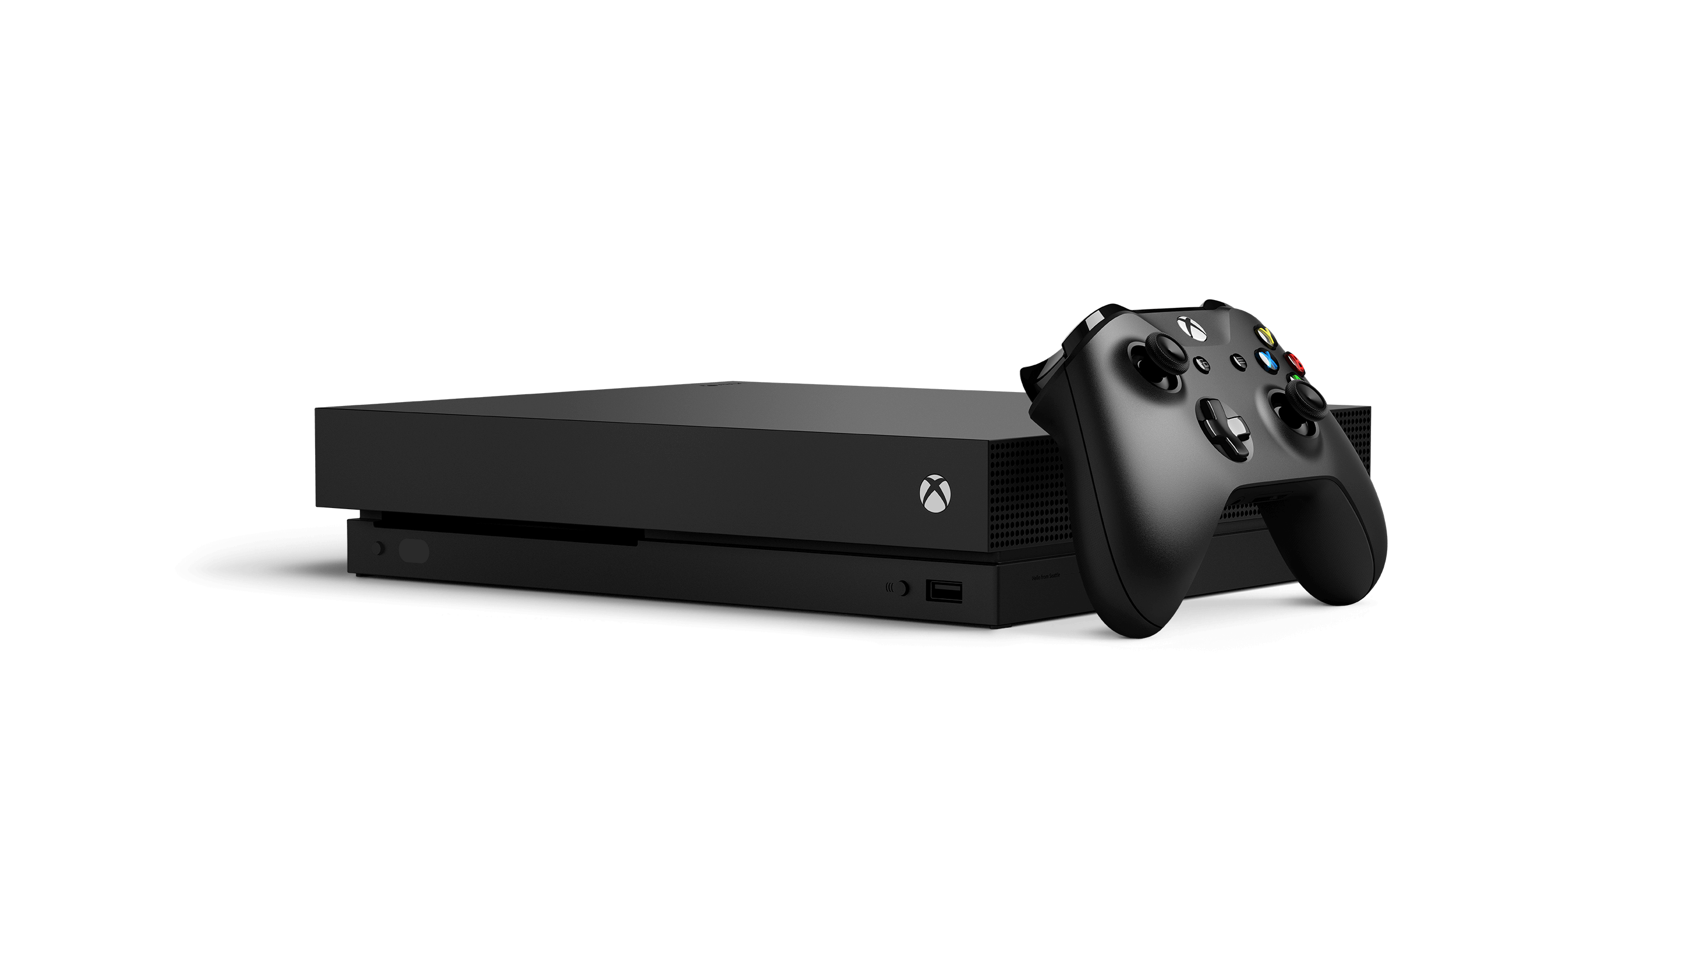
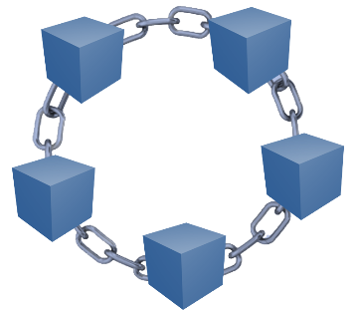


Game Services
Generalized Flow
Validators
Active Game Session
Valid Observation
Valid Observation
Invalid Observation
Report Suspicious
Valid Observation
Session End
Report Attestation
…
Validation Arbiter (Blockchain Oracle)
Report Attestation
Attestation Complete
Notes:
To keep things simple, lets assume that there is no dedicated server for our baseline, but that we do have a services ecosystem responsible for helping to facilitate multiplayer game sessions.
(CLICK) Players are matched into a game
(CLICK) The game host signals that the game is ready
A game service:
(CLICK) Creates an ephemeral blockchain, specific to the active game session
(CLICK) Recruits random players to serve as validators, generally preferring higher reputation players.
Since there are 4 players in the game, 8 will be recruited to ensure that there’s a 2/3 majority; even if all players in the game collude, they’re outnumbered
(CLICK) The service will request a trusted authority to serve as the validation arbiter in the form of a Blockchain Oracle.
Typically, this will be the dedicated server for a game session, if one exists
If not, it could take the form of another game service or other server. It needs to be fully trusted to act faithfully, it should not be under player control
(CLICK) The game begins and observations are sent to the blockchain as transactions
Transactions get packaged as blocks, but we’ll ignore that in the name of simplicity
Blocks and transactions are validated as possible, either during game play or after
If a validator sees something suspicious, it sends a transaction that flags the game for later review. This transaction is double-checked by the Oracle. If the Oracle agrees, the transaction cannot be rejected.
(WAIT)
Eventually the game will end
(CLICK) Each validator that wishes to receive credit for reviewing the game session sends a transaction that attests to the validation.
(CLICK) The Oracle has been tracking any red flags raised and communicates those and the attestations back to the game services.
At this point, the Oracle’s lifecycle is complete as far as cheat detection is concerned. It may be deallocated, reassigned, or whatever other action is needed.
(CLICK) The game services then tear down the Blockchain instance.
Remember, telemetry was also sent via the normal pipeline to be used for other areas; so there’s no need to preserve the transactions
You could use these instead of telemetry, but you may end up bifurcating your pipeline in some scenarios that we’ll talk
The game session is now complete.
Any suspicion of cheating was captured by the game services
Attestations for cheat review were captured by the game services
Next, lets talk about some possible twists…
(CLICK – TRANSITION)

Slide 16


Dealing With Sensitive Information
Game Services
Validators
Sensitive Observation
Sensitive Observation
Public Observation
Session End
Texas Hold ‘Em Session
Report Suspicious
Report Attestation
Attestation Complete
Game Server (Dealer + Oracle)
Notes:
One thing to be aware of when dealing with most Blockchains is that every member of the chain can see every transaction.
How do we deal with sending observations when they contain information that may compromise game integrity of players can see the information from other players?
For example, if we’re playing a game of Texas Hold ‘Em Poker
(CLICK)
In this case, we’ll assume that we have a dedicated server acting as the dealer and validation arbiter.
(CLICK)
Since we’ve already talked about the general flow, we’ll skip over some details; initialization is the same.
(CLICK)
Because the cards for each player shouldn’t be visible to other players, we need a way to hide them while still allowing the observations to be captured for later validation.
Also remember that the server should be able to see the cards, and that there are public cards, as the flop, river, and turn are revealed.
One common way to do this is to have the server or a game service issue a unique encryption key to each player.
(CLICK)
This is a symmetric encryption key, allowing the data to be decrypted by authorized parties.
Depending on your client/server architecture, you could also have the server responsible for emitting all observations, but we’ll stay decentralized for illustration.
(CLICK) As each observation with sensitive information is emitted, it is done with encrypted data to avoid other players and the validators from potentially cheating.
You could, if you wanted, allow the validators access to the encryption keys at the beginning of the game.
In theory, there should be enough randomization in selecting them that a player shouldn’t be able to collude with one… but I prefer not to trust that.
(CLICK) When the dedicated server marks the game as ended, it includes the encryption keys in the payload.
(CLICK) The validators can now read through and validate the transactions that were previously recorded.
As they did previously, the validators will flag any suspicious transactions, which the Oracle will report to the game services
(CLICK) Once again, the Oracle reports the results to the game services, which tear down the ephemeral Blockchain and clean up.
Of course, this is only one potential flow. There are multiple options, including:
Making the dedicated server responsible for emitting all events
Sharing encryption keys with validators at the start
Using Smart Contracts to communicate private data with the dedicated server responsible for sending an unlock at the end of the game
Some Blockchain instances even offer targeted Access Control Lists so that you could authorize the validators to see sensitive data while restricting other players
Since we started with Halo to frame the problem, it seems only fitting that we end back there.
(CLICK – TRANSITION)

Slide 17
Revisiting Halo
Many Observations During a Match
Duplicate Observations (different perspectives)
Easy to Accidentally Leak to Players
Highly Competitive (including professional tournaments)
Notes:
Halo is a great example of a complex scenario for cheat detection.
(CLICK) Halo is built heavily around telemetry
It makes a ton of observations during a game
Identifying which are important for cheat detection can be tricky
(CLICK) Observations are often duplicated from different player perspectives
Shared game world, players see and capture the same thing
Time sequencing may be different and is unreliable
(CLICK) There isn’t always a clean line between public data and sensitive data
For example, Player A may observe Player B in their line of sight
That data shouldn’t be shared with Player C across the map, as they shouldn’t know where Player B is
Similar scenario with events like picking up weapon
(CLICK) Halo was designed to be a competitive game, with eSports firmly in mind.
Because of the potential rewards and high stakes, players are aggressive in looking for advantages
We’ve seen a lot of collusion around ranking and similar.
Generally speaking, its better to obscure anything that may potentially give players an unfair advantage
Any exploits can weaken trust in the game and cost a non-trivial amount in professional tournaments and similar
While I believe that with careful design, Blockchain could be used for validation of Halo, I see it taking a longer time with more pre-processing and additional complexity.
It would be a fun challenge to think it all the way through and come up with a design.
If done correctly, it could potentially add value to spectating and broadcasting games
(CLICK – TRANSITION)

Slide 18

Summary
Cheat Detection is a Great Addition for Security
Nearly Free Labor Helps Control Cost
Cheaters Gonna Cheat
Blockchain Is a Peer-to-Peer Platform
Blockchain Doesn’t Mean:
Cryptocurrency
Massive Hardware Use
Incredibly Slow Throughput
Simple is Fast; Complex is Less Fast
Notes:
We covered a lot, and it’s been a bunch of me talking.
Thanks for sticking with me.
To summarize:
(CLICK) Cheat detection is a great addition to layered security and validation.
It should be used as part of a layered strategy, not the only option
(CLICK) Distributing cheat detection to player volunteers can potentially help keep costs down when compared to centralized analysis.
We can potentially filter a large percentage of game sessions from the need to review within the game services ecosystem and instead concentrate on a much smaller number where our volunteers believe there was something suspicious.
Helpful to incentivize this will non-material rewards like reputation
(CLICK) Psychology tells us that cheaters are very likely to keep cheating; miss them the first time and you will probably still catch them
You likely still want to audit some random games too, as another layer
(CLICK) Blockchain provides an interesting platform for distributing these duties, since it was made to handle collecting, collating, and validating transactions in a peer-to-peer manner.
Out of the box, it provides P2P communication, validation, and a means for achieving consensus on “what happened” without the need to write it ourselves
There are many different Blockchain implementations, with characteristics that vary wildly.
(CLICK) Blockchain does not necessarily mean:
Cryptocurrency
Massive hardware use
Incredibly slow throughput
(CLICK) Simple scenarios can be validated in near real-time
The more complexity, the more likely it is that you’ll need to do more post-processing
I’ve included some references that may be helpful; The deck is located in my “Presentations” repository in GitHub, for those interested.
(CLICK – TRANSITION)

Slide 19

References
General
The Cheater’s High (pdf)
Blockchain Concepts
Byzantine Fault Tolerance (Wikipedia)
BFT in the Blockchain Context
A (short) Guide to Consensus Protocols
Technical
Tendermint Documentation
Application Blockchain Interface Specification
Notes:
Anyone want to capture any of this before we skip over?
It’s more for use when reading the deck
(CLICK FOR TRANSITION)

Slide 20
Twitter: | @Jesse_Squire
GitHub: | https://www.github.com/jsquire
LinkedIn: | https://www.linkedin.com/in/JesseSquire
Biography: | https://www.jessesquire.com/about
Jesse Squire
Senior Software Engineer, Microsoft
Notes:
Here’s where you can find me.
Any questions or things that you’d like to discuss?

